Slide 1
CEM/
SCEM
CEM/
SCEM
CEM/
SCEM
BPM
AEM
BPM
AEM
BPM
AEM
BPM
-
+
-
-
+
-
-
+
-
-
+
+
+
+
+
-
-
-
-
-
-
-
-
+
+
+
+
+
+
+
-
-
-
-
+
-
+
-
+
-
Electrode Chamber
Seawater Brine Chamber
Acid Chamber
Base Chamber
Acid flow
Base flow
Seawater brine flow
Electrode flow
Notes:
Fig. 1 The configuration of lab-scale experimental BMED stack.

Slide 2
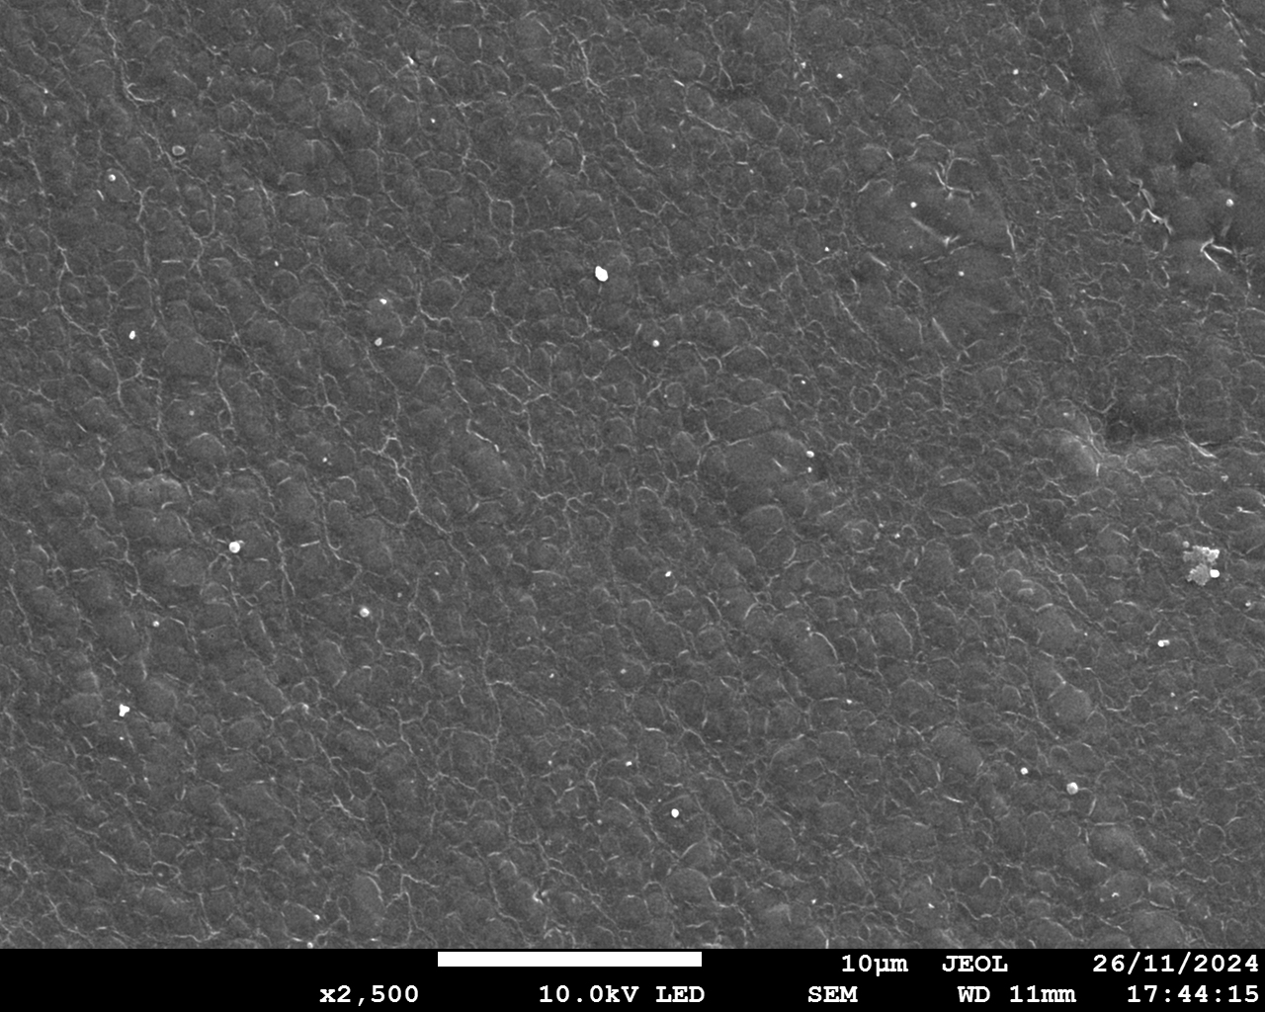
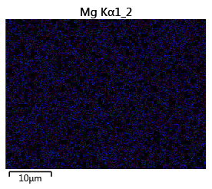
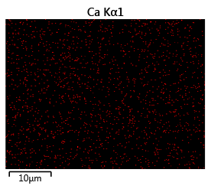
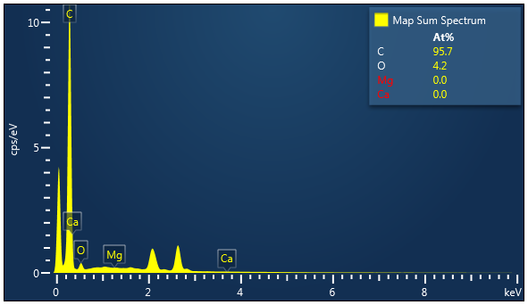
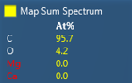
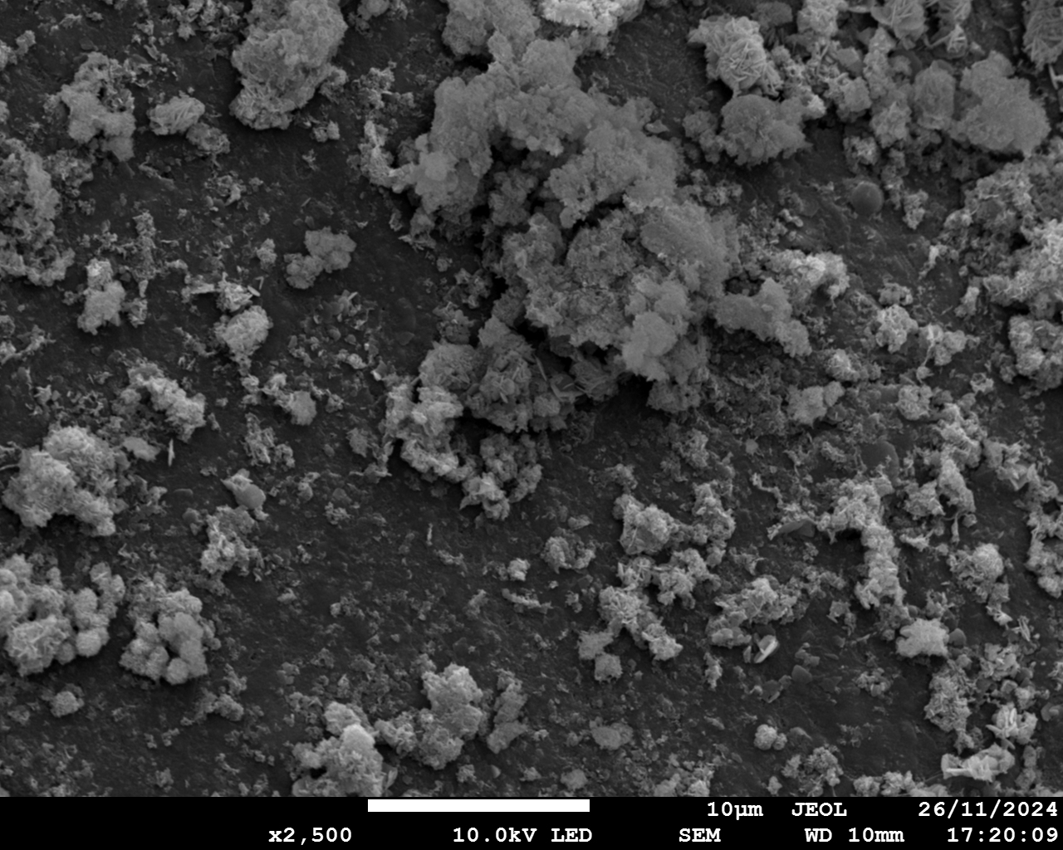
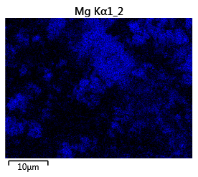
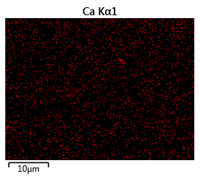
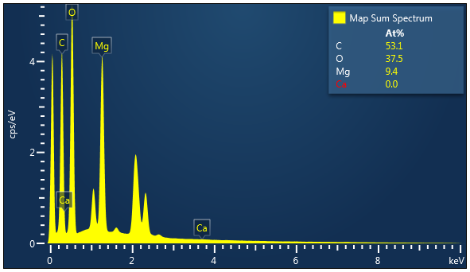
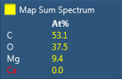
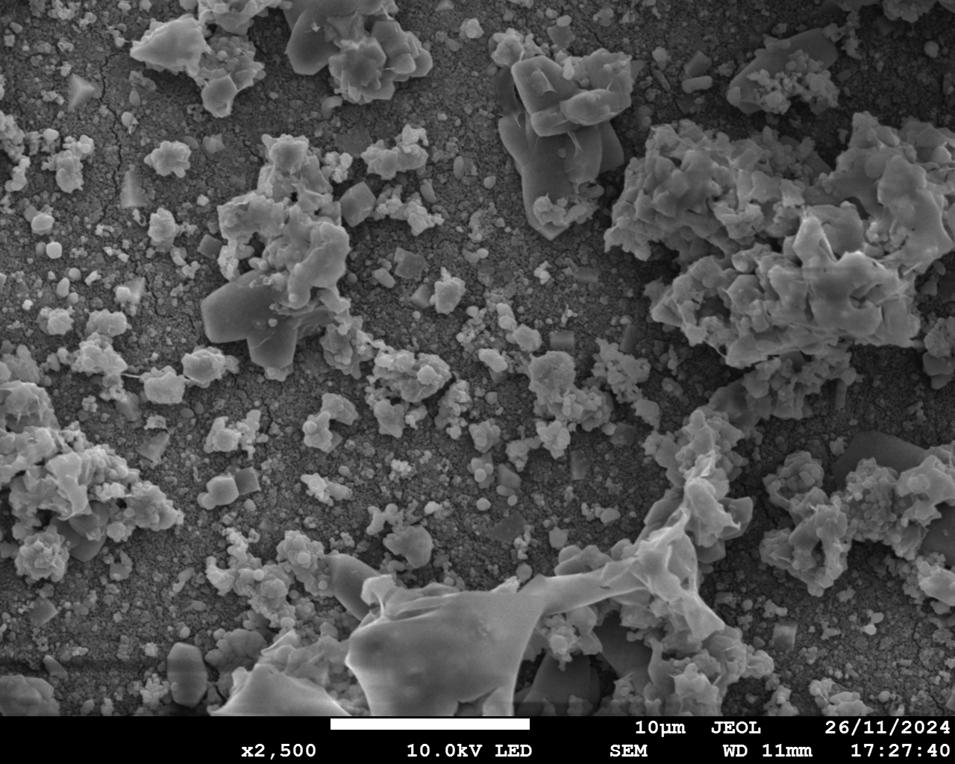
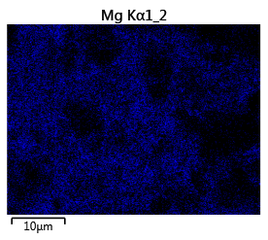
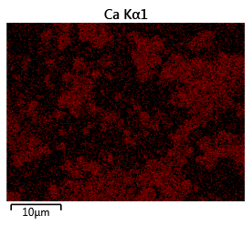
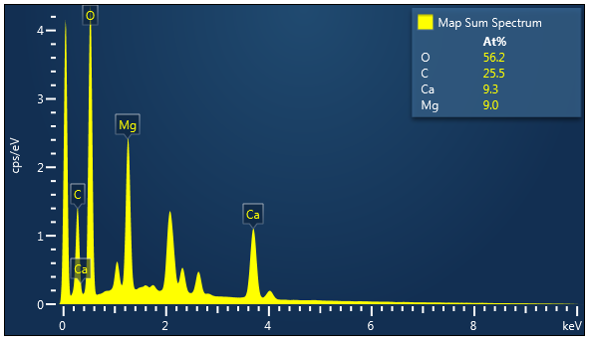
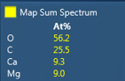
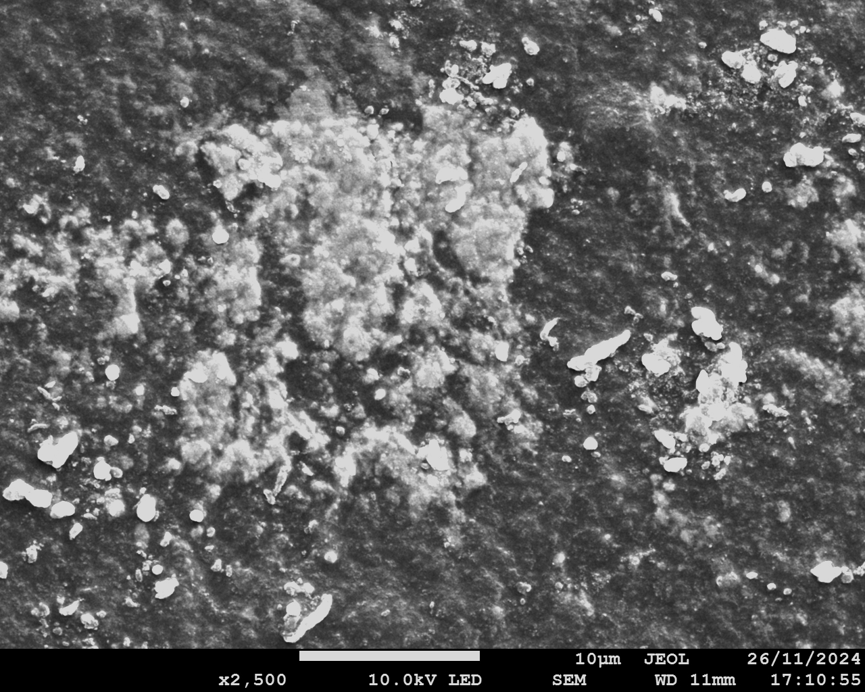
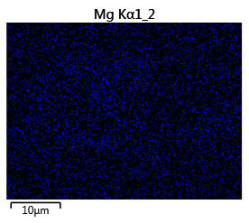
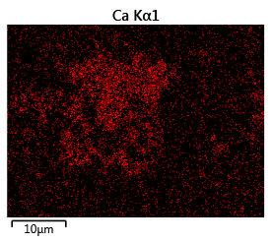
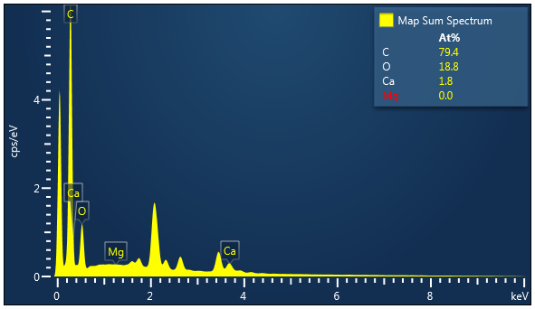
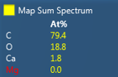
a1
a2
Mg
a3
Ca
a4
AEM facing SWBC
10 μm
10 μm
10 μm
b1
b2
Mg
b3
Ca
b4
CEM facing SWBC
10 μm
10 μm
10 μm
c1
c2
c3
c4
Mg
Ca
CEM facing BC
10 μm
10 μm
10 μm
d1
d2
Mg
d3
Ca
d4
BPM facing BC
10 μm
10 μm
10 μm
Notes:
Fig. 2 SEM and EDS elemental analysis of membrane surfaces. AEM facing SWBC: (a1) SEM diagram; (a2) EDS elemental mapping image of Mg; (a3) EDS elemental mapping image of Ca; (a4) EDS map spectrum. CEM facing SWBC: (b1) SEM diagram; (b2) EDS elemental mapping image of Mg; (b3) EDS elemental mapping image of Ca; (b4) EDS map spectrum. CEM facing BC: (c1) SEM diagram; (c2) EDS elemental mapping image of Mg; (c3) EDS elemental mapping image of Ca; (c4) EDS map spectrum. BPM facing BC: (d1) SEM diagram; (d2) EDS elemental mapping image of Mg; (d3) EDS elemental mapping image of Ca; (d4) EDS map spectrum. (Conditions: Feed solution = seawater brine, current density = 15 mA/cm², cell pairs = 3, membrane = CEM. AC: acid chamber; SWBC: seawater brine chamber; BC: base chamber).

Slide 3
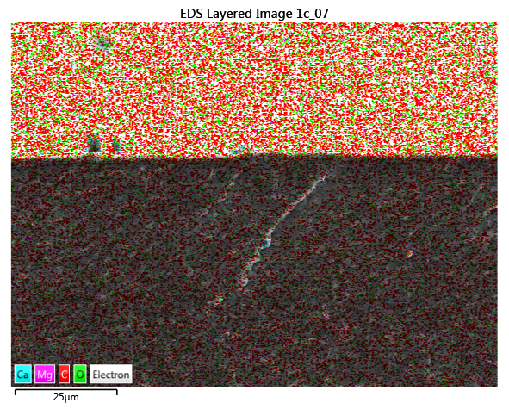
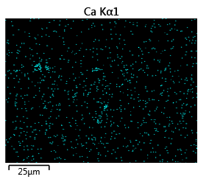
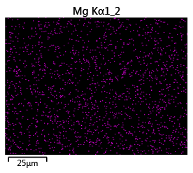
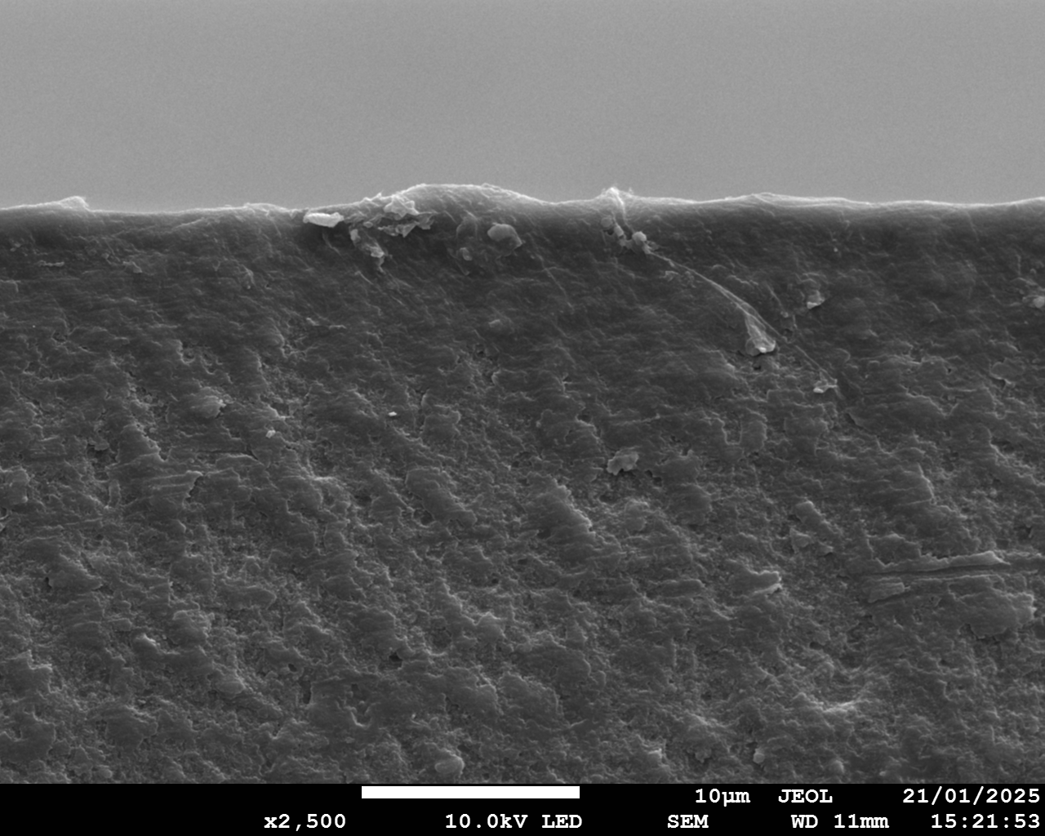
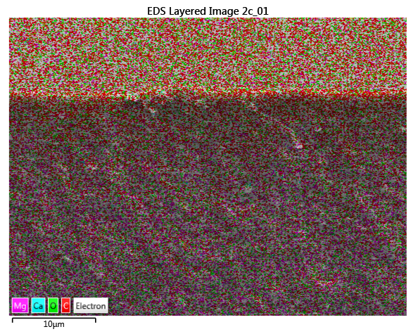
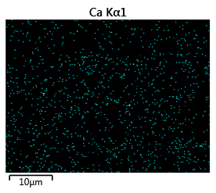
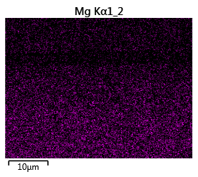
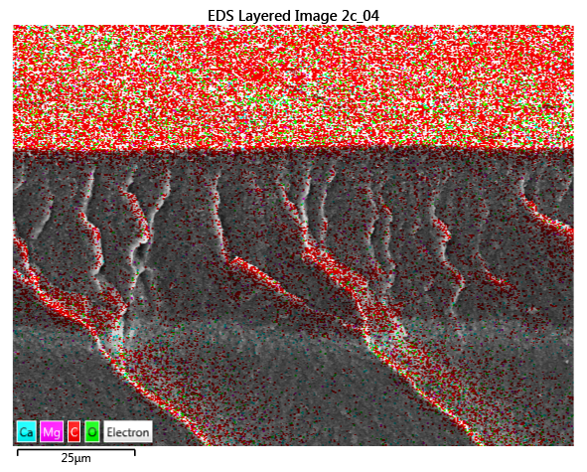
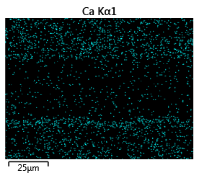
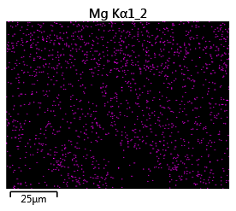
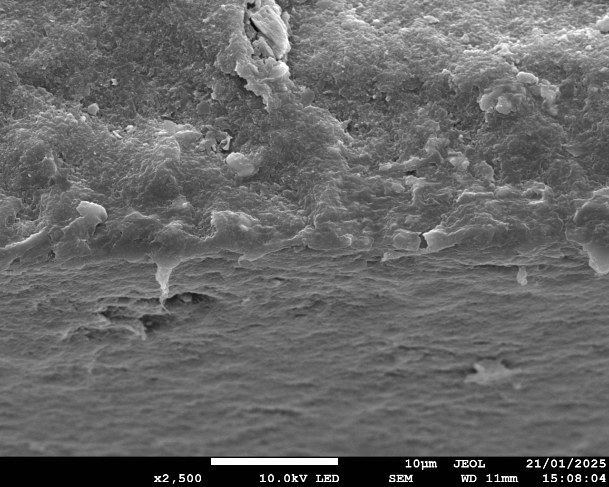
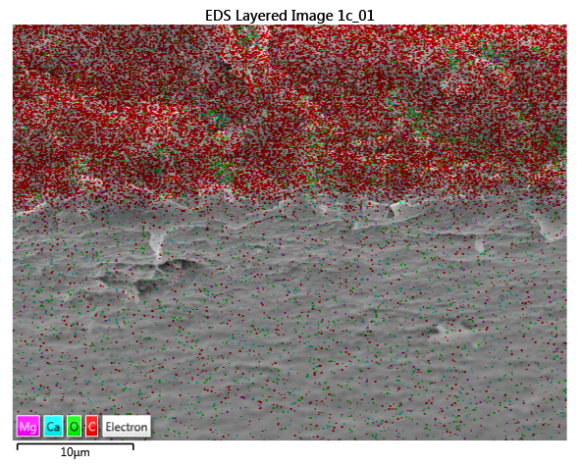
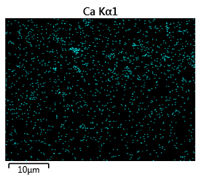
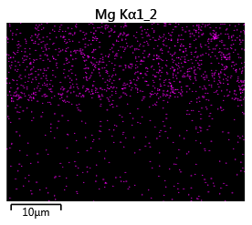
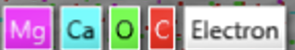
a1
a2
a3
Ca
a4
Mg
Surface
Pristine CEM
Cross-section
10 μm
10 μm
10 μm
10 μm
b1
b2
b3
b4
Mg
Ca
Surface
Cross-section
CEM
After
Experiment
10 μm
10 μm
10 μm
10 μm
c1
c2
c3
c4
Mg
Ca
Pristine BPM (AEL)
Cross-section
Surface
10 μm
10 μm
10 μm
10 μm
d1
d2
d3
d4
Mg
Ca
Cross-section
BPM (AEL)
After Experiment
Surface
10 μm
10 μm
10 μm
10 μm
Notes:
Fig. 3 The SEM graph and EDS map spectrum of cross-section of membranes (White line is the dividing line of cross-section and membrane surface). Pristine CEM: (a1) SEM diagram; (a2) EDS map spectrum; (a3) EDS elemental mapping image of Ca; (a4) EDS elemental mapping image of Mg. CEM after experiment: (b1) SEM diagram; (b2) EDS map spectrum; (b3) EDS elemental mapping image of Ca; (b4) EDS elemental mapping image of Mg. Pristine BPM (AEL): (c1) SEM diagram; (c2) EDS map spectrum; (c3) EDS elemental mapping image of Ca; (c4) EDS elemental mapping image of Mg. BPM (AEL) after experiment: (d1) SEM diagram; (d2) EDS map spectrum; (d3) EDS elemental mapping image of Ca; (d4) EDS elemental mapping image of Mg.

Slide 4
a
1
3
Scaling on CEM/SCEM
facing SWBC
Scaling on BPM
facing BC
Scaling: Mg(OH)₂
The leakage of OH⁻
Water splitting
Scaling: Ca(OH)₂
The transport of Mg²⁺/Ca²⁺
BPM
BPM
AEM
CEM/SCEM
BPM
BPM
EC
AC
+
SWBC
-
BC
EC
3
+
-
OH⁻
Cl⁻
Ca²⁺
1
-
+
Water splitting
H+
…
OH⁻
…
+
(Major)
2
-
H⁺
Leakage
H⁺
OH⁻
+
OH⁻
-
OH⁻
(Minor)
Ca²⁺
Mg²⁺
Na⁺
+
Mg²⁺
Ca²⁺
Na⁺
-
+
-
2
Scaling on CEM/SCEM
facing BC
Scaling: Mg(OH)₂, Ca(OH)₂, CaCO₃
The transport of Mg²⁺/Ca²⁺
b
CEM/SCEM
CEM/SCEM
CEM/SCEM
CEM/SCEM
SWBC
BC
SWBC
BC
SWBC
BC
SWBC
BC
2
1
1
OH⁻
H⁺
OH⁻
Water
Splitting
H⁺
Mg²⁺
Ca²⁺
Mg²⁺
Ca²⁺
Mg²⁺
Ca²⁺
Mg²⁺
Ca²⁺
OH⁻
OH⁻
Water
Splitting
H⁺
OH⁻
OH⁻
Water
Splitting
H⁺
Scaling
Scaling
Divalent ion transport
Precipitate on membrane surface facing BC
Scaling reduce A_{eff}, decreasing I_{lim}.
Water splitting takes place and produces OH⁻ and H⁺
OH⁻ transports through the membrane and precipitates on membrane facing SWBC
Scaling on membrane surface facing SWBC attributes to water splitting as well
The scaling was enhanced
Scaling on membrane surface
Notes:
Fig. 4 (a) Schematic illustration of mechanisms of scaling generation in BMED system (EC: electrode chamber; AC: acid chamber; SWBC: seawater brine chamber; BC: base chamber). (b) The procedure of scaling formation on both sides of CEM/SCEM. (A_{eff} = effective membrane area; I_{lim} = limiting current)

Slide 5
b
CEM/SCEM
CEM/SCEM
CEM/SCEM
CEM/SCEM
SWBC
BC
SWBC
BC
SWBC
BC
SWBC
BC
2
1
1
Nanocrystal
in matrix
OH⁻
H⁺
OH⁻
Water
Splitting
H⁺
Mg²⁺
Ca²⁺
Mg²⁺
Ca²⁺
Mg²⁺
Ca²⁺
Mg²⁺
Ca²⁺
OH⁻
OH⁻
Water
Splitting
H⁺
OH⁻
OH⁻
Water
Splitting
H⁺
Scaling
Scaling
Divalent ion transport
Precipitate on membrane surface facing BC
Scaling reduce A_{eff}, decreasing I_{lim}.
Water splitting takes place and produces OH⁻ and H⁺
OH⁻ transports through the membrane and precipitates on membrane facing SWBC
Scaling on membrane surface facing SWBC attributes to water splitting as well
The scaling was enhanced
Scaling on membrane surface
Nanoparticles in matrix

Slide 6
a
b
Notes:
Figure 5 Quantification of scaling in BMED system. (a) Reduction ratio of Mg²⁺ and Ca²⁺ with time; (b) The amount of scaling in BMED. (Conditions: Feed solution = seawater brine, current density = 15 mA/cm², cell pairs = 3, membrane = CEM).

Slide 7
a
b
c
d
e
f
Notes:
Figure 6 (a) Conductivity changes in salt chamber and (b) Voltage changes in BMED system treating NaCl and SWB. (c) Concentration of generated acid and base with time. (d) pH change in the salt chamber. The current efficiency and energy consumption of the entire process to produce (e) acid and (f) base. (Conditions: Feed solution = NaCl or SWB, current density = 15 mA/cm², cell pairs = 3, membrane = CEM)

Slide 8
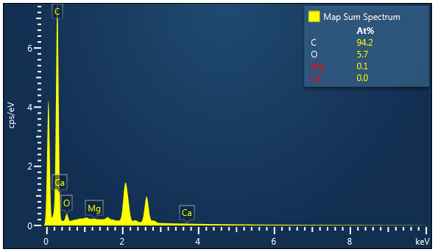
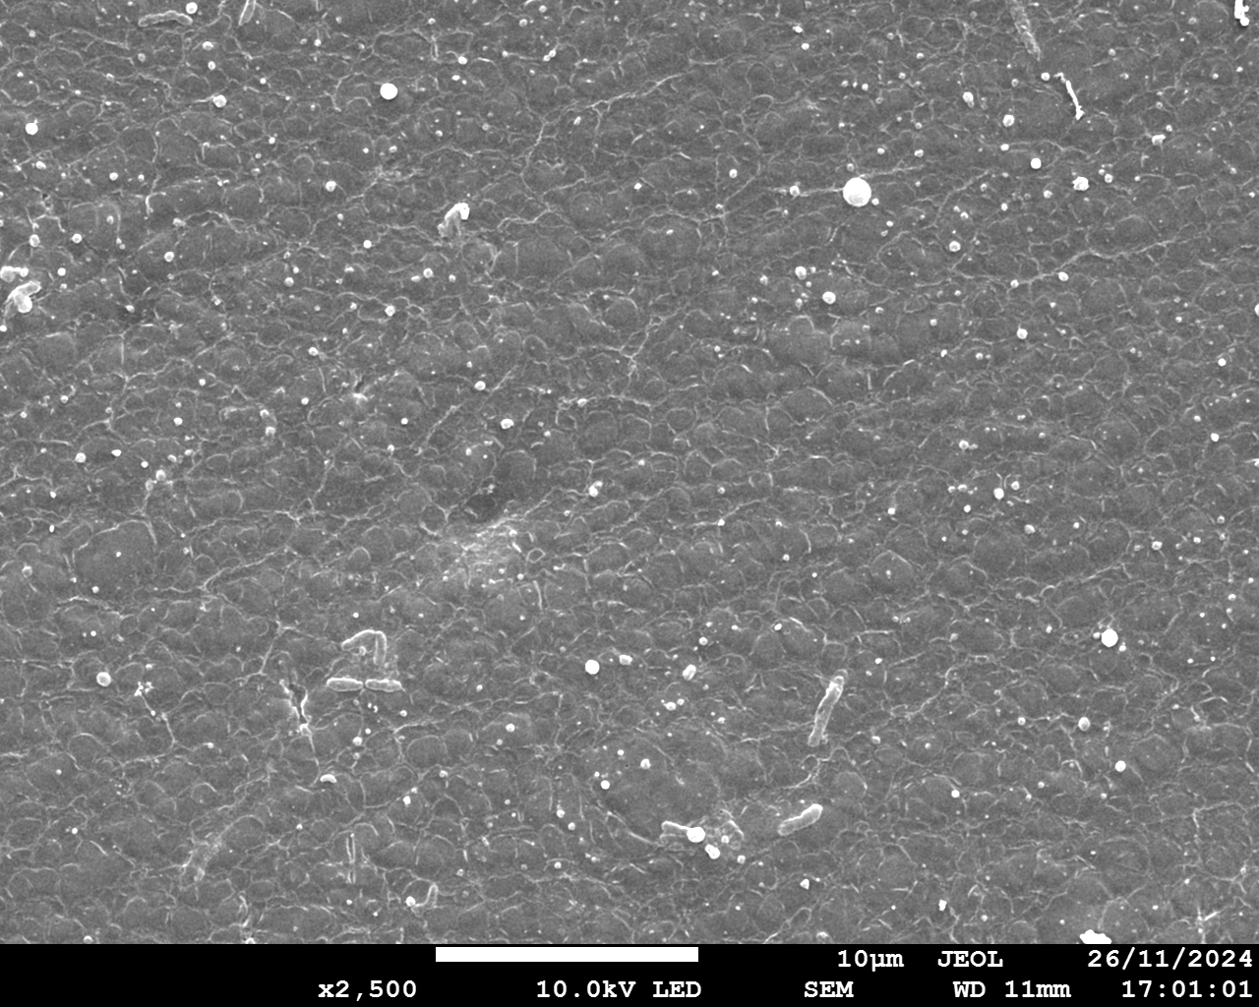
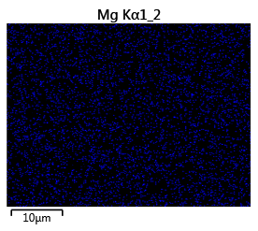
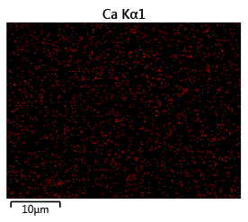
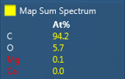
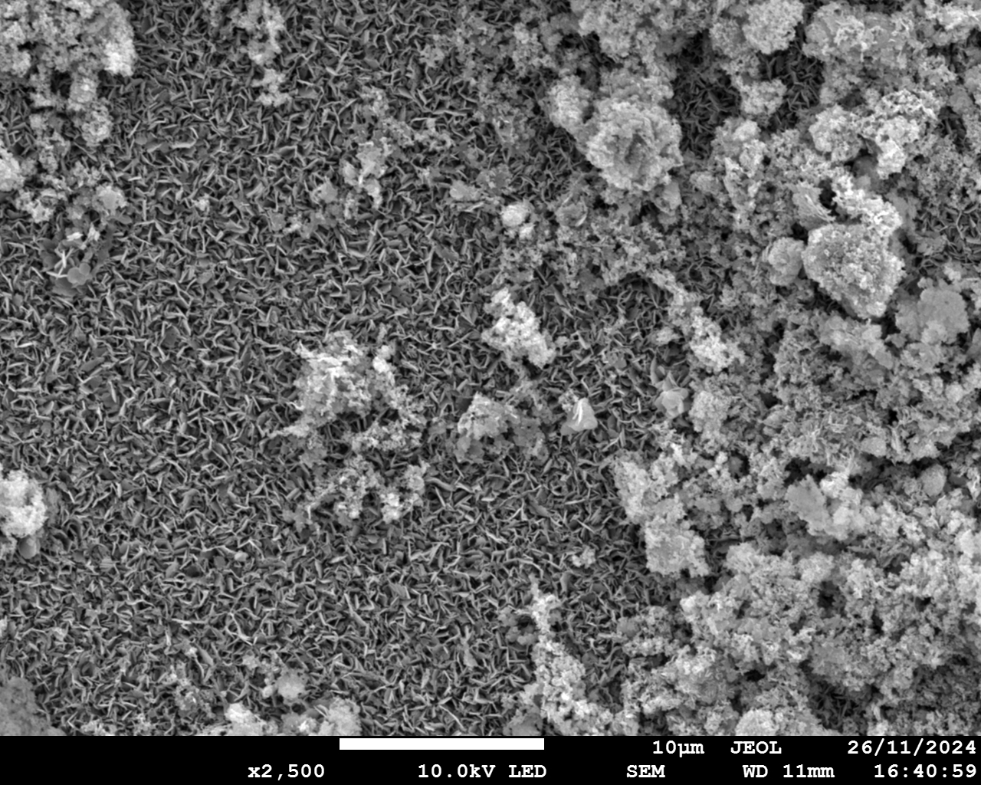
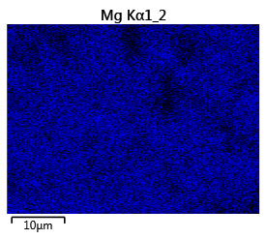
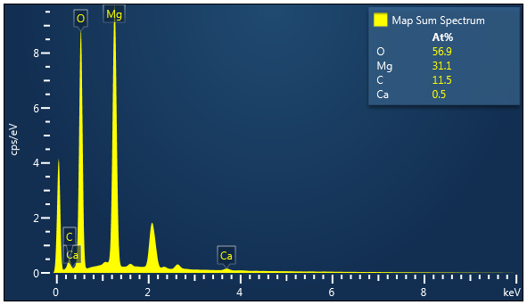
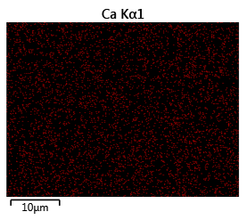
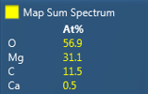
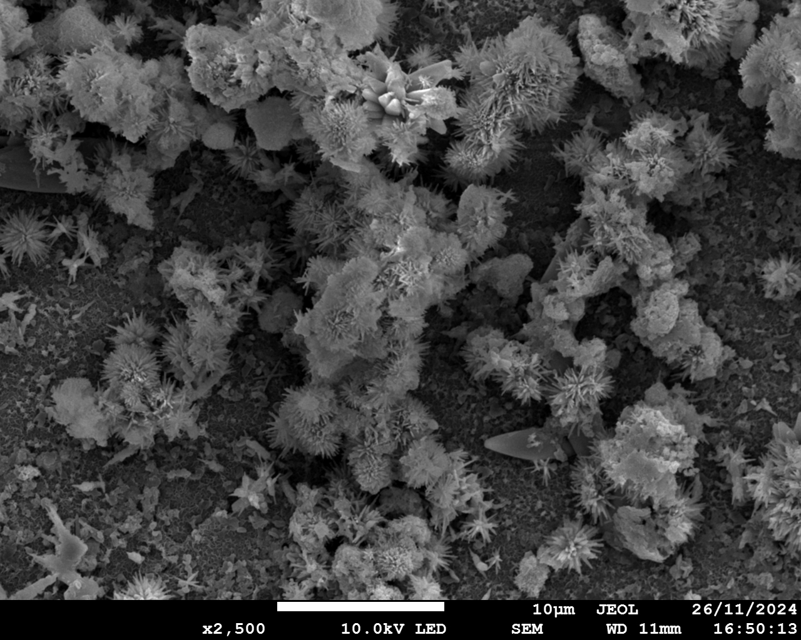
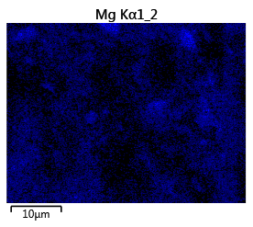
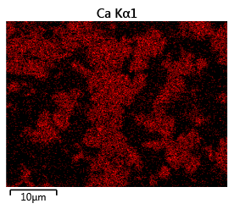
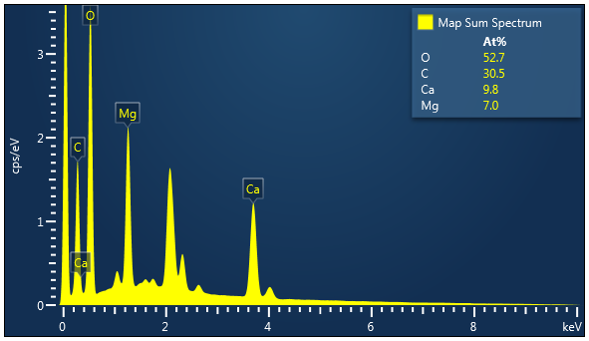
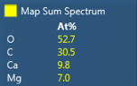





a1
a2
Mg
a3
Ca
a4
AEM facing SWBC
10 μm
10 μm
10 μm
b1
b2
Mg
b3
b4
Ca
SCEM facing SWBC
10 μm
10 μm
10 μm
c1
c2
c3
c4
Mg
Ca
SCEM facing BC
10 μm
10 μm
10 μm
d1
d2
d3
d4
Mg
Ca
BPM facing BC
10 μm
10 μm
10 μm
Notes:
Figure 7. SEM and EDS elemental analysis of membrane surfaces. AEM facing SWBC: (a1) SEM diagram; (a2) EDS elemental mapping image of Mg; (a3) EDS elemental mapping image of Ca; (a4) EDS map spectrum. SCEM facing SWBC: (b1) SEM diagram; (b2) EDS elemental mapping image of Mg; (b3) EDS elemental mapping image of Ca; (b4) EDS map spectrum. SCEM facing BC: (c1) SEM diagram; (c2) EDS elemental mapping image of Mg; (c3) EDS elemental mapping image of Ca; (c4) EDS map spectrum. BPM facing BC: (d1) SEM diagram; (d2) EDS elemental mapping image of Mg; (d3) EDS elemental mapping image of Ca; (d4) EDS map spectrum. (Conditions: Feed solution = seawater brine, current density = 15 mA/cm², cell pairs = 3, membrane = SCEM. AC: acid chamber; SWBC: seawater brine chamber; BC: base chamber).

Slide 9
a
b
Notes:
Figure 8 Quantification of scaling in BMED system. (a) Reduction ratio of Mg²⁺ and Ca²⁺ in BMED system treating SWB and (b) The amount of scaling in BMED system with different membrane stack. (Conditions: Feed solution = SWB, current density = 15 mA/cm², cell pairs = 3, membrane = CEM (baseline, BL) and SCEM).

Slide 10
a
b
c
d
e
f
Notes:
Figure 9 (a) Conductivity change in salt chamber and (b) Voltage change with different membrane stack. (c) Concentration of generated acid and base with different membrane stack. The current efficiency and energy consumption of the entire process to produce (e) acid and (f) base with different membrane stack. (Conditions: Feed solution = SWB, current density = 15 mA/cm², cell pairs = 3, membrane = CEM (BL) and SCEM).

Slide 11
a
b
Notes:
Figure 10 Quantification of scaling under different current. (a) Reduction ratio of Mg²⁺ and Ca²⁺ in BMED system treating SWB and (b) The amount of scaling in BMED system under different current density. (Conditions: Feed solution = SWB, cell pairs = 3, membrane = SCEM, current density = 15 (BL), 12 and 9 mA/cm²).

Slide 12
a
b
c
d
e
f
Notes:
Figure 11 (a) Conductivity change in salt chamber and (b) Voltage change with time under different current density. (c) Concentration of generated acid and base under different current density. The current efficiency and energy consumption of the entire process to produce (e) acid and (f) base under different current density. (Conditions: Feed solution = SWB, cell pairs = 3, membrane = SCEM, current density = 15 (BL), 12 and 9 mA/cm²).

Slide 13




a
b
10 μm
c
Mg
d
Ca
10 μm
10 μm
Notes:
Figure S 1 Characterization of CEM (Conditions: feed solution = NaCl, current density = 15 mA/cm², cell pairs = 3). (a) SEM graph; (b) EDS map spectrum; (c) EDS elemental mapping image of Mg; (d) EDS elemental mapping image of Ca.

Slide 14








a1
a2
a3
a4
AEM facing SWBC
CEM facing SWBC
CEM facing BC
BPM facing BC
b1
b2
b3
b4
AEM facing SWBC
SCEM facing SWBC
SCEM facing BC
BPM facing BC
Notes:
Figure S2 The photo of membranes after test. BMED with CEM: (a1) AEM facing SWBC; (a2) BPM facing BC; (a3) CEM facing SWBC; (a4) CEM facing BC. BMED with SCEM: (b1) AEM facing SWBC; (b2) BPM facing BC; (b3) SCEM facing SWBC; (b4) SCEM facing BC.

Slide 15
Brucite Mg(OH)₂
Calcite CaCO₃
NaCl
Notes:
Fig S3. X-ray diffraction spectra for the precipitates collected on membrane.

Slide 16













Ca
Mg
Scaling on
CEM facing
SWBC
Mg(OH)₂
1 μm
1 μm
1 μm
Ca(OH)₂
Ca
Mg
Mg(OH)₂
1 μm
1 μm
1 μm
Scaling on
CEM facing
BC
Ca
Mg
Mg(OH)₂
1 μm
1 μm
1 μm
Notes:
Fig. S3 The morphology of crystal on (a) CEM facing SWBC and (b) CEM facing BC.

Slide 17
a1
a2
a3
b1
b2
b3
Notes:
Fig. S5 The concentration change of Mg²⁺ and Ca²⁺ with different membrane in (a1) acid, (a2) base, and (a3) SWB chamber and under different current densities in (b1) acid, (b2) base, and (b3) SWB chamber.

Slide 18
BPM
O₂
-
H₂
H⁺
+
OH⁻
+
-
-
OH⁻
H⁺
+
-
Electrode Chamber
Na₂SO₄
Notes:
Figure S6. Schematic experimental setup for determining the electrode resistance. (Conditions: electrode solution = 0.3 M Na₂SO₄, current density = 5~20 mA/cm²)

Slide 19
Notes:
Figure S7 Voltage drop of the electrode compartments as a function of direct current.(The read line is the fitting curve)

Slide 20
a
b
c
d
Notes:
Figure S8. (a) The resistance change of membrane and chamber over time when treating NaCl or SWB. (b) The relationship between chamber resistance and total resistance in the BMED system during the treatment of SWB and NaCl solutions. (Conditions: Feed solution = NaCl or SWB, current density = 15 mA/cm², cell pairs = 3, membrane = CEM)

